Slide 1

HallyuGo:
A Guide Map to Discover and Visit K-Contents and K-Culture Hotspots
Team 4.75 김지수 이유진 정대교 Jose Antunes

Slide 2
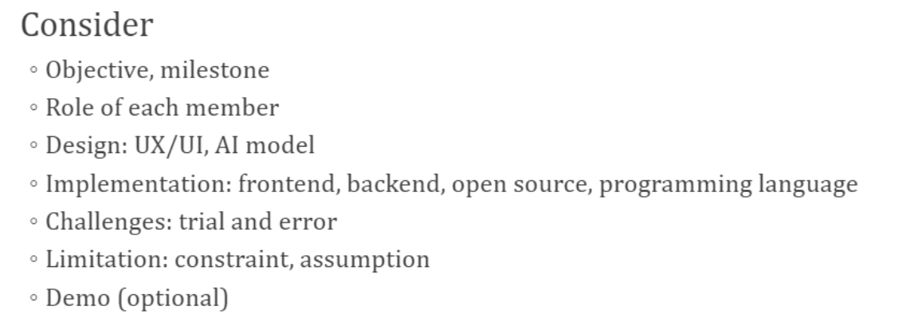
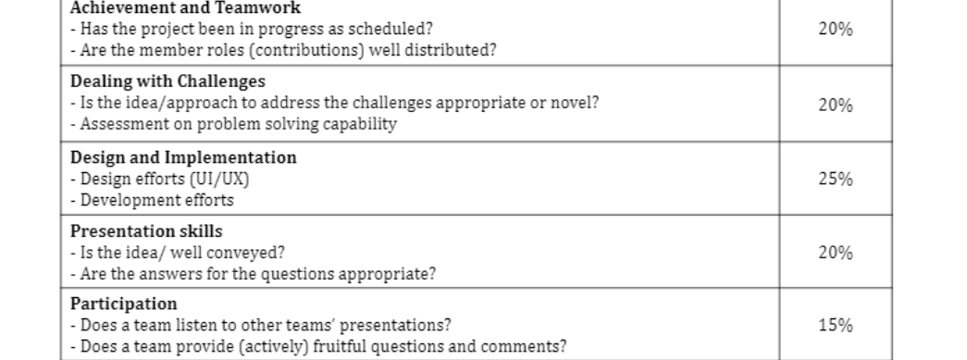
Guideline & Evaluation Criteria

Slide 3
Title(Open Sans, 굵게, 28pt)
content(Open Sans, 중간, 22pt)
- element 1
- element 2
- element 3
Please do not delete this slide.
You can copy this slide if you want to make new one.
Please follow the above form.

Slide 4
Objective
🎯Target
Anyone who loves K-Contents and K-Culture, including visitors
🎯What
Information of hotspots related to K-Contents and K-Culture
🎯How
Guide map application for K-Contents and K-Culture hotspots

Slide 5
Schedule
Weeks | 2 - 3 | 4 - 5 | 6 - 7 | 8 - 9 | 10 - 11 | 12 - 13 | 14 - 15
Refinement of Topic
UI & UX Design
DB Design
Implementation
Data Collection
Testing & Deployment

Slide 6
Milestone
Status | Tasks
Completion | Entity & Repository implementation, UI/UX design, DB design
In progress | Data collection Implementation
Next | Data collection Implementation

Slide 7
Roles
Name | Role
Daegyo | DB design, API design, Back-end ‘auth’ implementation
Yoojin | UI/UX design, Front-end setup & development
Jisu | API design, Data Collection, Back-end ‘domain’ and ‘repository’ implementation
Jose | Front-end Development, Data Collection

Slide 8
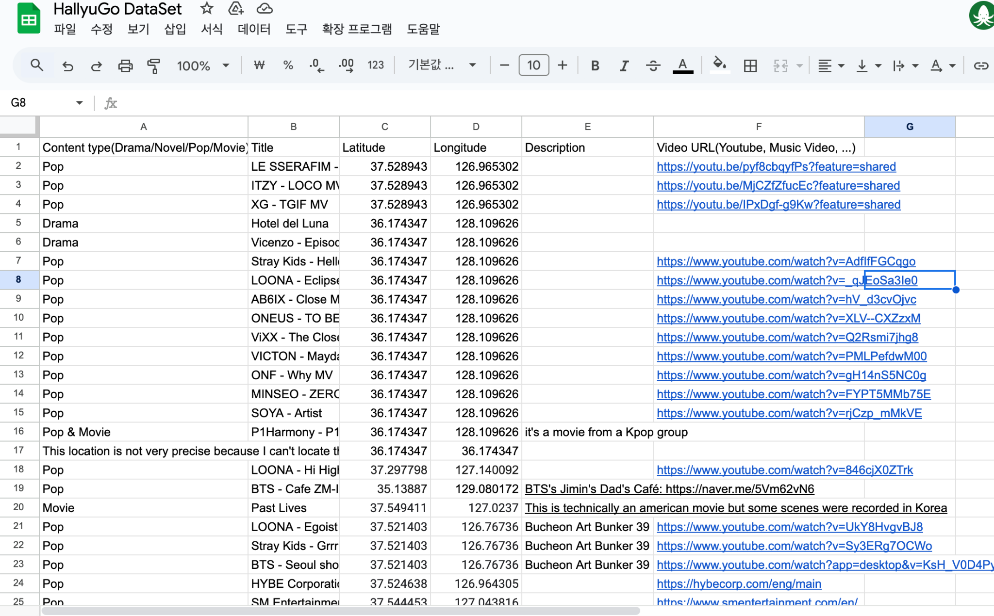
Datasheet
Content Type
Title
Latitude
Longitude
Description
Video URL
Notes:
explain how to separate components

Slide 9
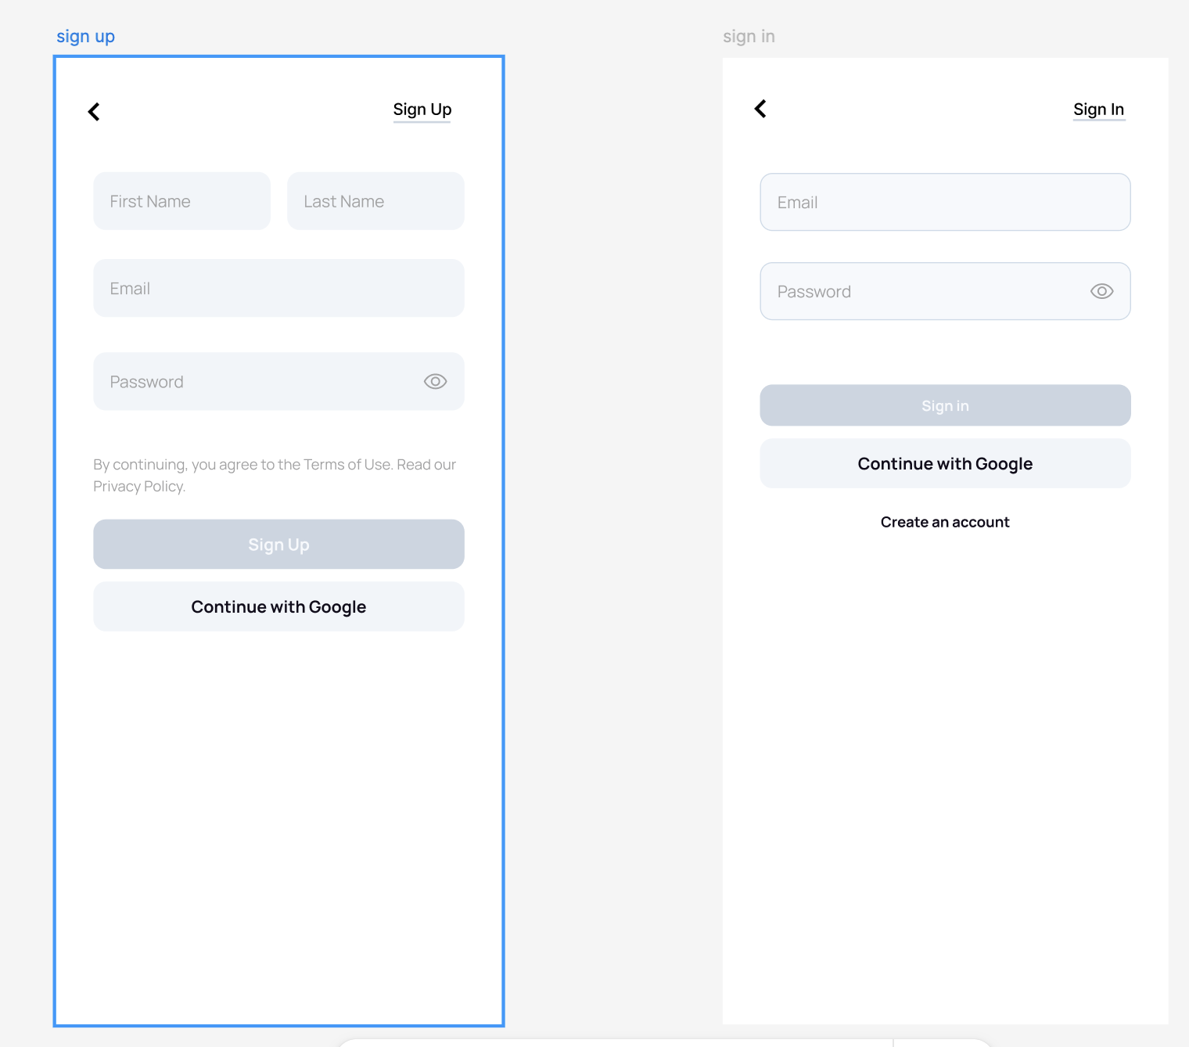
Design: Sign up & Sign in
Notes:
explain how to separate components

Slide 10
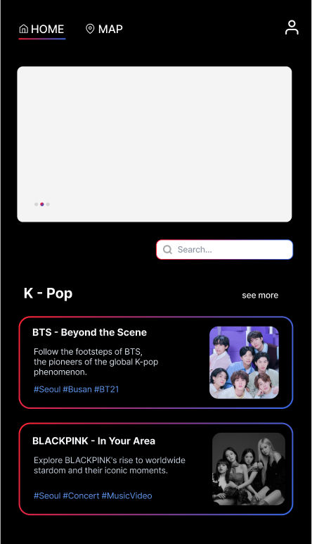
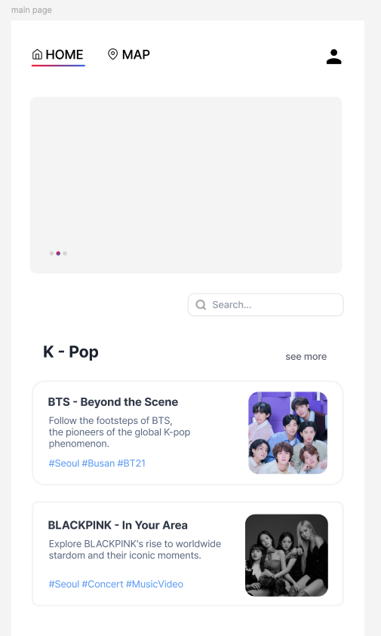
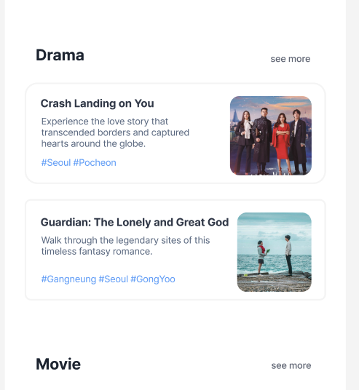
Design: Main Page
Dark Mode?
Header
Carousel
Searchbar
CategoryBox
ContentCard
Notes:
explain how to separate components

Slide 11
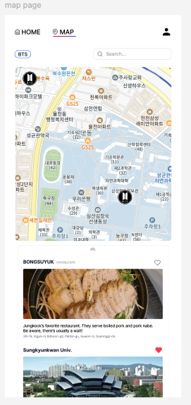
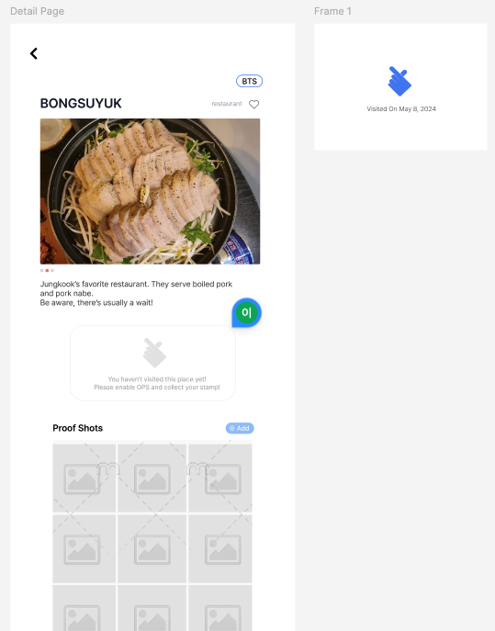
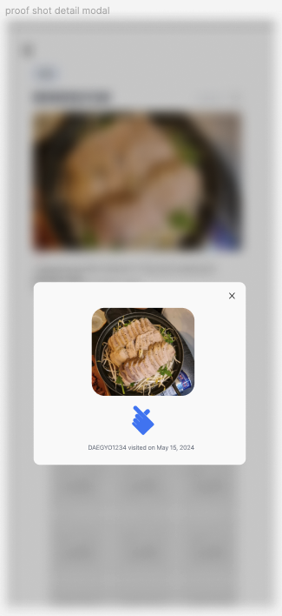
Design: Map Page & Detail Page
Header
Map
stamp
& proof shots
DetailList
DetailCard

Slide 12
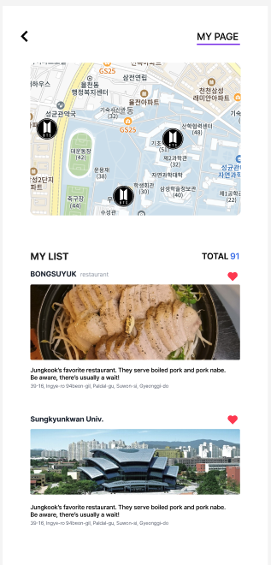
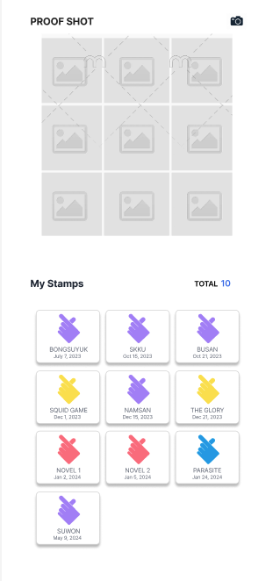
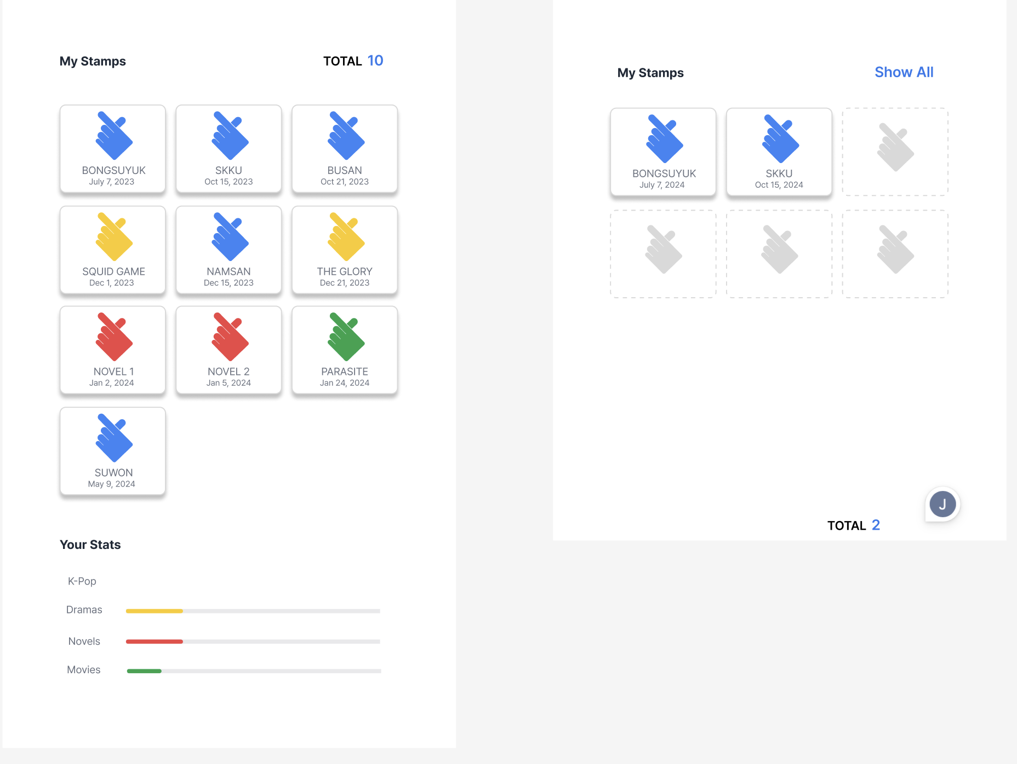
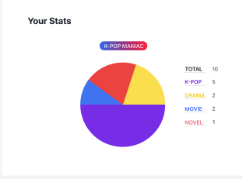
Design: My Page
ProofShot
Map
MyProof
Shots
Stats
Detail
Card
MyList
Stamp
MyStamps

Slide 13
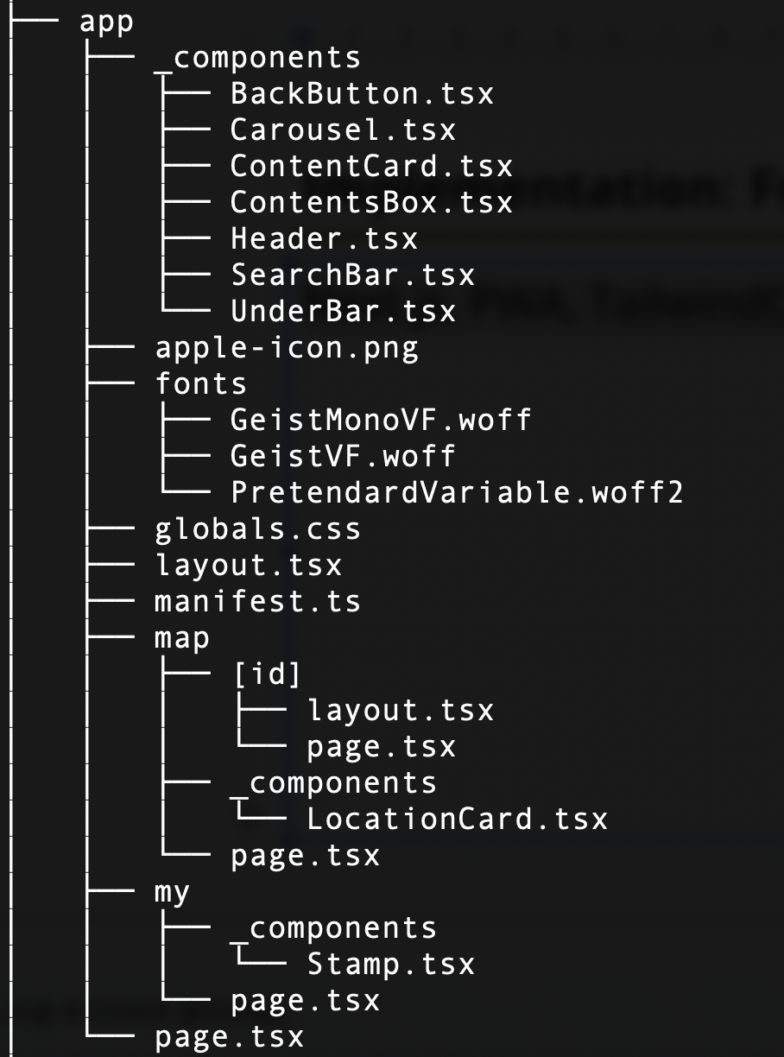
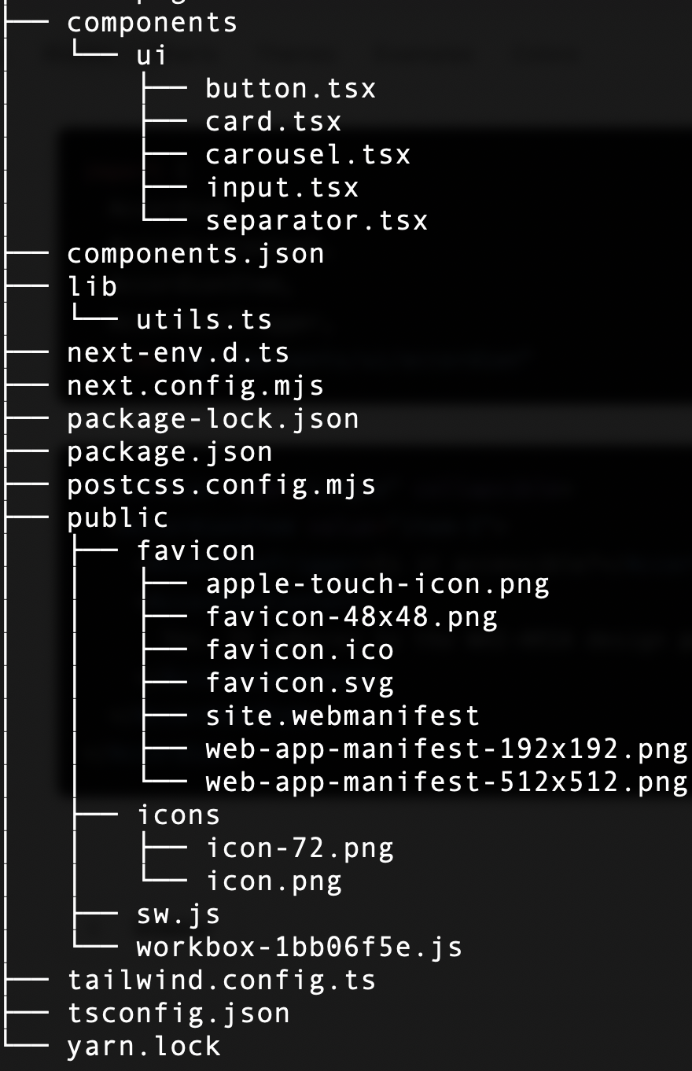
Implementation: Frontend
Next.js
Next.js
app router
ShadcnUI
(UI component library)
typescript

Slide 14
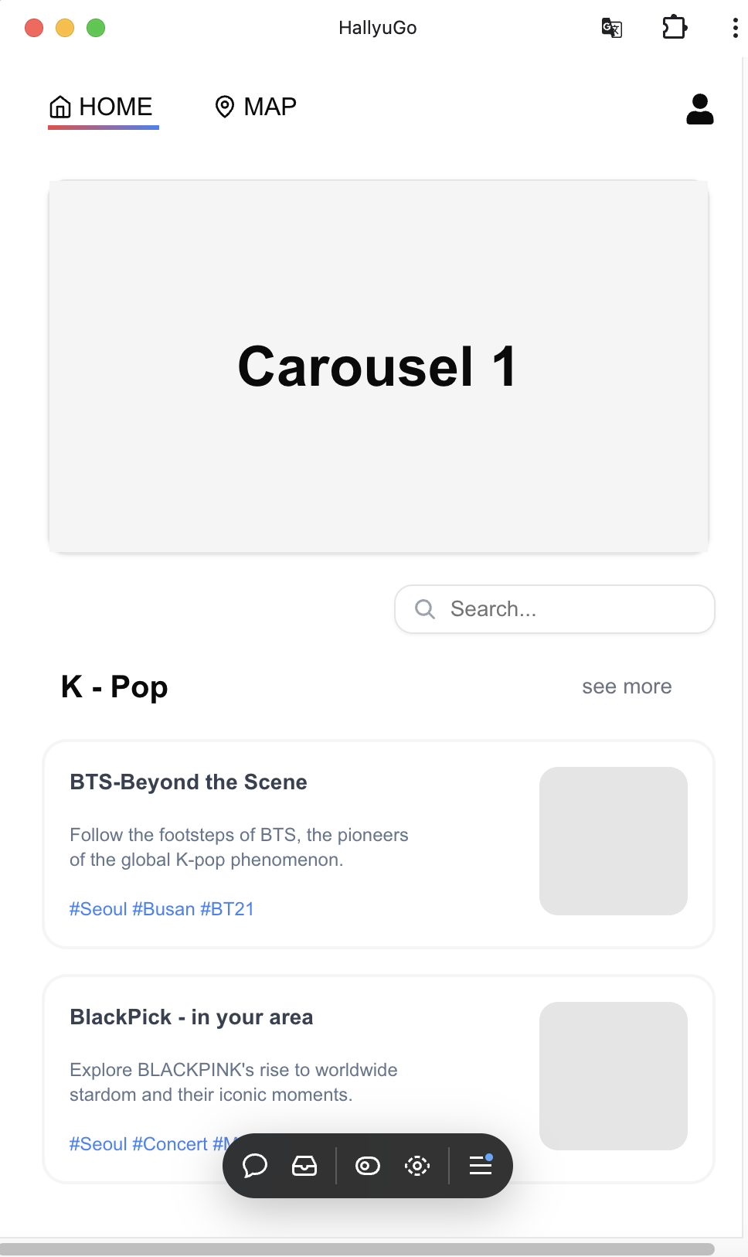
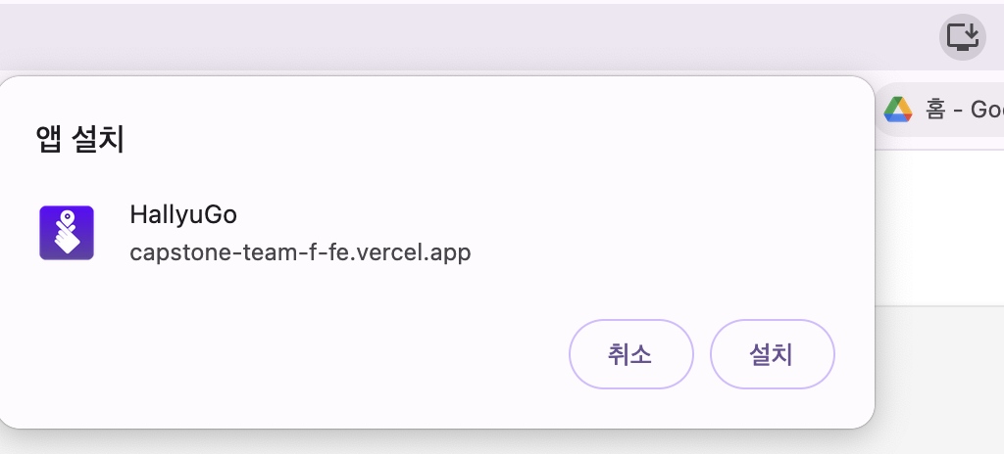
Implementation: Frontend
PWA
- https://capstone-team-f-fe.vercel.app/
- Temporal deployment for front-end

Slide 15
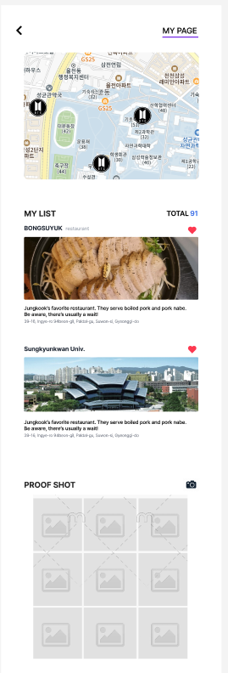
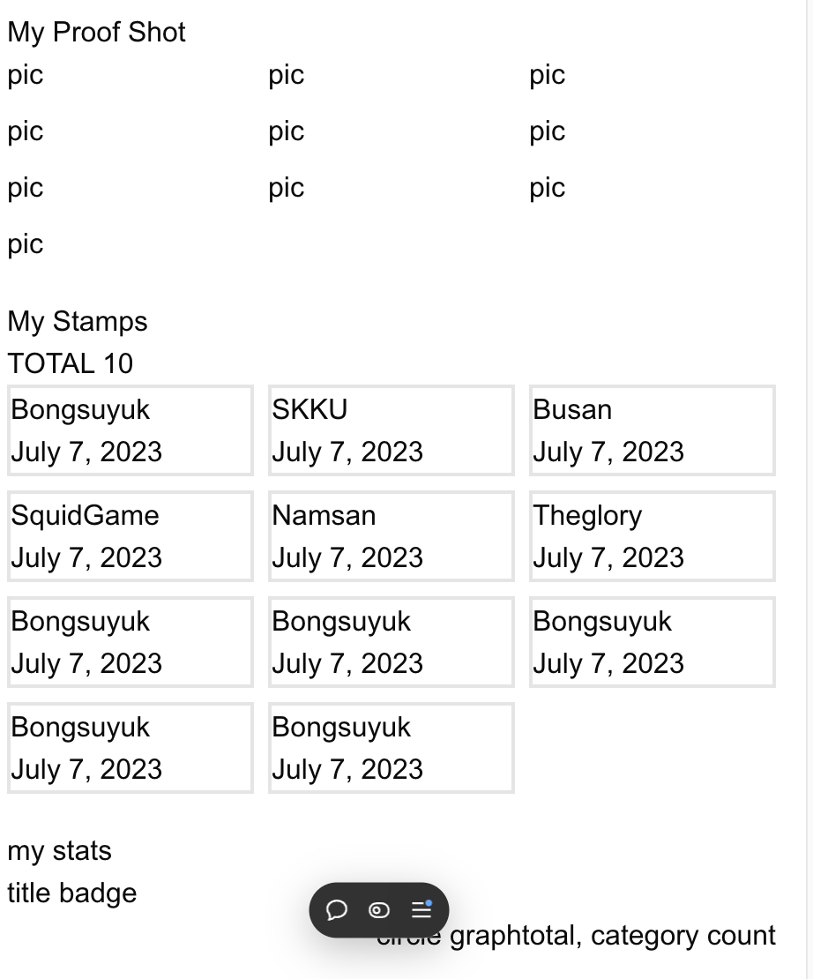
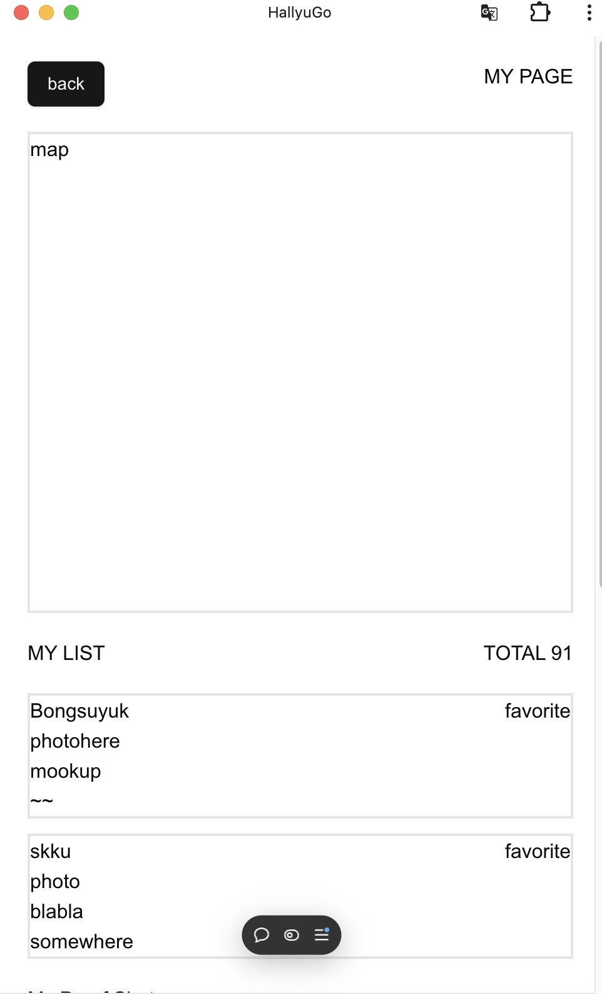
Implementation: Frontend - My Page
Basic Layout implementation
Figma

Slide 16
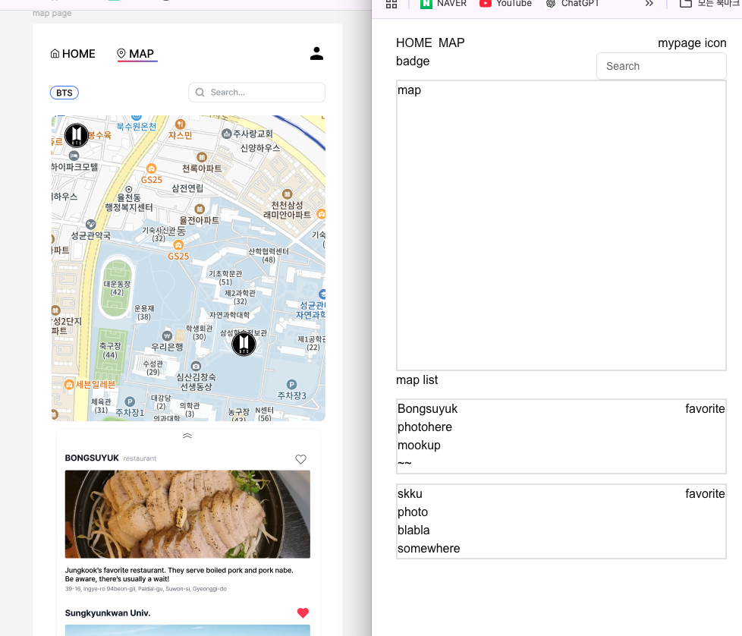
Implementation: Frontend - Map Page
Basic Layout implementation
Figma

Slide 17
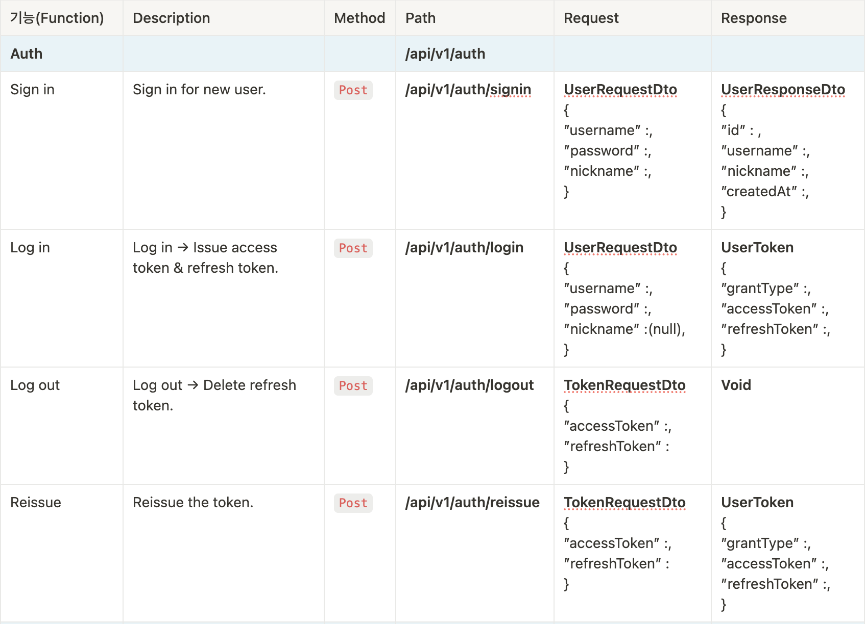
Implementation: Backend
API documentation: ex) Auth API
Notes:
From now on, I will explain the backend part. I'm Ji-Su Kim / in charge of backend development.
First, we documented API to request and response. And we started implementing API
For example, this is a part of authentication API documentation.

Slide 18
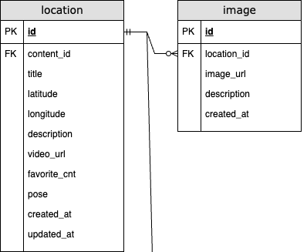
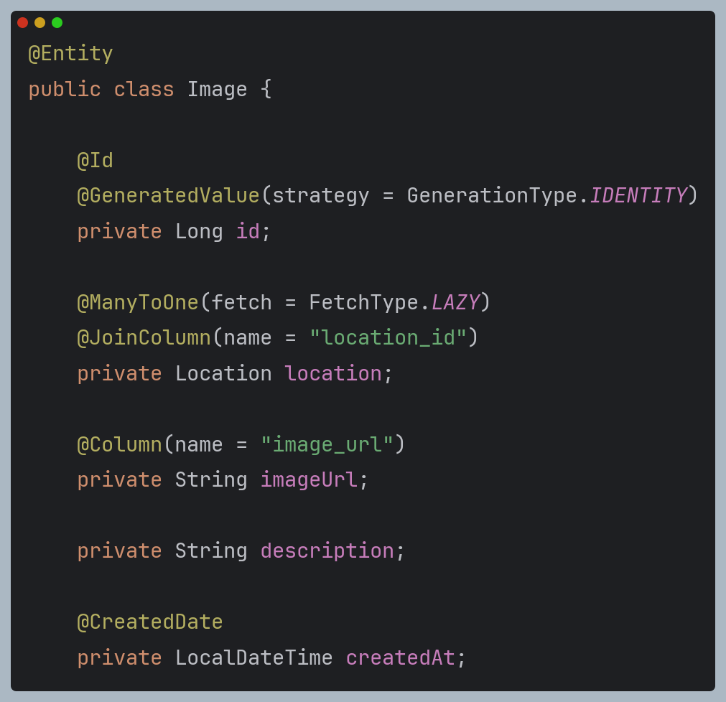
Implementation: Backend
Entity & Repository with JPA (Java Persistence API) + Spring
One : Many
Notes:
Next, we defined database table as entity, and implemented repository.
The figure on the left shows location table, image table and their relationship. One location can have many images, so we can say it "one to many", relationship.
Using jpa(java persistence API), we can make each table an entity and define their columns in the field. And, In Image entity on the right side, you can see “many to one” relationship in the square.
—---
Entity: set of data
Repository: interface for using methods to access database tables generated by entities
JPA is an API for managing mapping between objects and relational databases in Java. JPA allows developers to reduce the creation of complex sql queries.
persistence == Objects permanently stored in the database

Slide 19
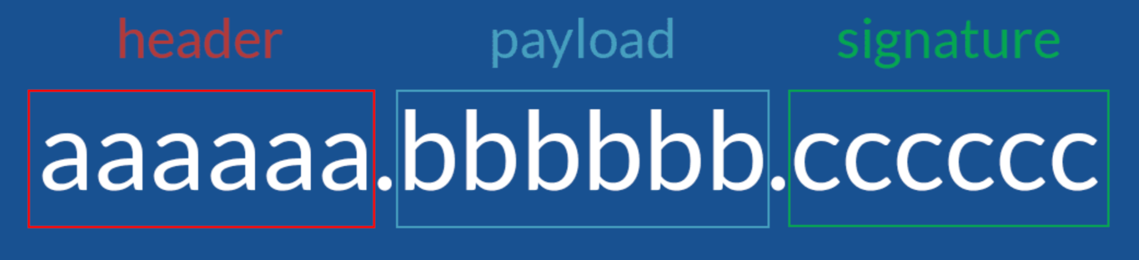
Implementation: Backend
Authentication with JWT (Json Web Token)
Encryption algorithm
& Type of token
Claims
[Header + Payload]
+
Secret Key
Notes:
Next, we implemented the authentication feature/ using JWT(Json web token).
JWT consists of header, payload, and signature.
Header has information about encryption algo./ and type of token.
Payload has some data called claim/ that we really want to provide, like user id
Finally, Signature has the result of encrypting the header and payload/ using the secret key.
so, signature is used to verify/ that the token is modified, in the middle. —---------------------------
헤더 (Header) 어떠한 알고리즘으로 암호화 할 것인지, 어떠한 토큰을 사용할 것 인지에 대한 정보가 들어있다.
정보 (Payload) 전달하려는 정보(사용자 id나 다른 데이터들, 이것들을 클레임이라고 부른다)가 들어있다. payload에 있는 내용은 수정이 가능하여 더 많은 정보를 추가할 수 있다. 그러나 노출과 수정이 가능한 지점이기 때문에 인증이 필요한 최소한의 정보(아이디, 비밀번호 등 개인정보가 아닌 이 토큰을 가졌을 때 권한의 범위나 토큰의 발급일과 만료일자 등)만을 담아야한다.
서명 (Signature) 가장 중요한 부분으로 헤더와 정보를 합친 후 발급해준 서버가 지정한 secret key로 암호화 시켜 토큰을 변조하기 어렵게 만들어준다. 한가지 예를 들어보자면 토큰이 발급된 후 누군가가 Payload의 정보를 수정하면 Payload에는 다른 누군가가 조작된 정보가 들어가 있지만 Signatute에는 수정되기 전의 Payload 내용을 기반으로 이미 암호화 되어있는 결과가 저장되어 있기 때문에 조작되어있는 Payload와는 다른 결과값이 나오게 된다. 이러한 방식으로 비교하면 서버는 토큰이 조작되었는지 아닌지를 쉽게 알 수 있고, 다른 누군가는 조작된 토큰을 악용하기가 어려워진다

Slide 20
Implementation: Backend
Why JWT?
1️⃣ JSON-based
Easy!
2️⃣ Self-contained
All necessary information within token itself
3️⃣ No session management Stateless server
Notes:
There are many advan-tage to jwt.
First, because it is Json-based, it is easy to understand
Second, it includes all necessary informations within token itself, so addi-tional database queries are not required.
finally, no session management. Tokens are stored on the client side, but sessions are stored on the server side. So using jwt instead of session, the server can be stateless. This means that server does not need to remember the client's status.
—------
JSON-Based
Easy to Understand: The JWT format is human-readable, making it easier to debug and troubleshoot issues.
Self-Contained
Using Claims: JWT includes all the necessary information within the token itself, such as user identity and authorization details, eliminating the need for additional database queries during authentication.
No Session Management
JWT allows the server to be stateless, as it does not require maintaining user session data on the server side, simplifying scalability and reducing server memory usage.
세션과 토큰은 어떻게 다른가?
세션은 데이터베이스 서버에 저장되고(세션 저장소라는 곳에서 클라이언트의 상태를 저장), 토큰은 클라이언트 측에 저장된다.
세션은 사용자가 인증에 성공한 상태를 말하고, 토큰은 권한이나 자격(Qualifications)을 나타내는 징표
그리고 웹 표준이라서 대부분의 언어가 jwt를 지원함.And since jwt follows web standards, most languages support jwt.

Slide 21





Challenges: How to Handle Refresh Token
Notes:
But there's a big problem with jwt. Of course we can get convenience by using it, But this means that if someone steals my token, that person can pretend to be me.
Short expiration can be a solution, but then user has to log in frequently. This is so inconvenient.

Slide 22


Challenges: How to Handle Refresh Token
Access Token
Short expiration
Refresh Token
Long expiration
Notes:
To solve this problem, access token with short expiration and refresh token with long expiration are both u-sed.
By using Refresh token, we can issue new access token. Therefore, we need to save refresh token for security.

Slide 23
Challenges: How to Handle Refresh Token
Need to save Refresh Token for: Security
"When a token is stolen by a malicious user,
the stored Refresh Token can enhance security." Token Revocation & Token Expiration and Renewal

Slide 24
Challenges: How to Handle Refresh Token
Store in MySQL DB? Hmmm…
1️⃣ Performance Degradation Slow…
2️⃣ Management Complexity Need additional logic, code, and process…
Notes:
Here, we faced a challenge. We had to decide/ how to handle the refresh token.
Like other data, we can store it in mysql db. However, there are the following disadvantages.
first, storing and retrieving the tokens from database are slow. This can lead to significant performance degradation, especially when there are many clients.
second, management complexity. To manage and handle the expiration of token, we need additional logic, code, and process.
—--------
MySQL DB에서 관리하는 것도 가능은 하지만 다음과 같은 문제와 불편함이 있음
1. Performance Degradation 쿼리 처리 시간도 있고..
Speed Issue: Storing and retrieving tokens from the database each time involves I/O operations, which can be slower than direct memory access. This can lead to significant performance degradation, especially when there are many users.
2. Management Complexity
Data Maintenance: Additional logic is required for managing token expiration and handling expiry. Extra code and processes are needed to appropriately manage tokens once they expire.

Slide 25
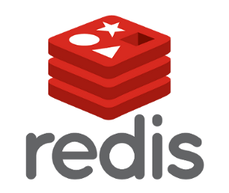
Challenges: How to Handle Refresh Token
Redis
1️⃣ In-Memory
Light
2️⃣ Key-Value
Higher speed
3️⃣ “timeToLive” property
Easy to handle expiration
Notes:
Therefore, we use Redis.
Redis is in-memory database so it saves and manages data in Random Access Memory..
And, because it is key -value database, we can access data in constant time. we can get higher speed.
finally, by using "time to live" property, we can manage expiration of the refresh token automatically.
—---------
Because it's an in-memory database, there's a drawback that it disappears when you turn off the computer. But when we log out, the token disappears anyway.
앞선 문제를 해결해 줄 방법으로 Redis를 사용해 관리
인 메모리 데이터베이스이면서( 데이터를 RAM(메모리)에 저장하여 처리하는 방식)
key-value 형식이라 가볍고 O(1)에 데이터 접근 가능
timetolive 설정을 사용해 자동으로 expiry 관리 용이

Slide 26
Limitation: Constraint and Assumption
content

Slide 27
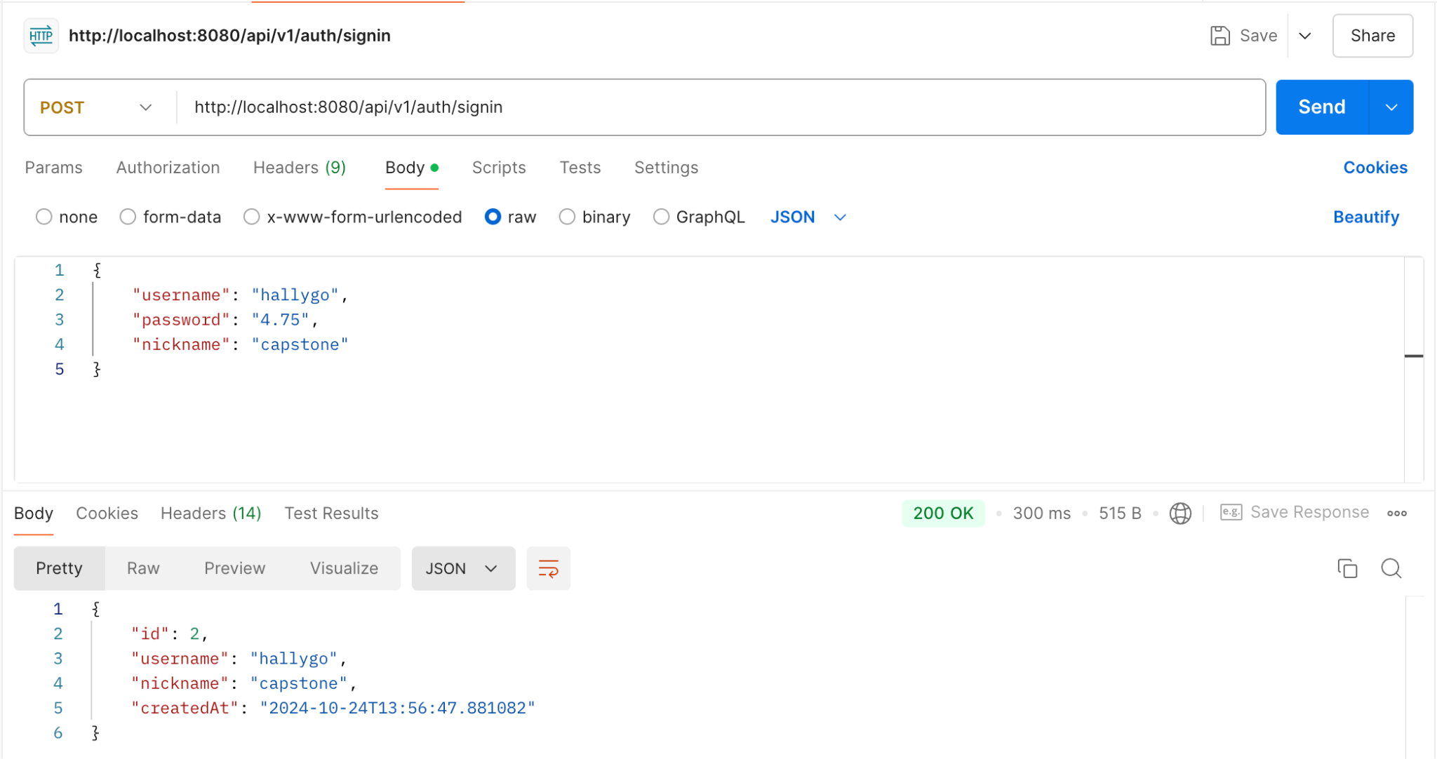
Demo : Auth Test
Sign In
Notes:
This is an authentication test using postman.

Slide 28
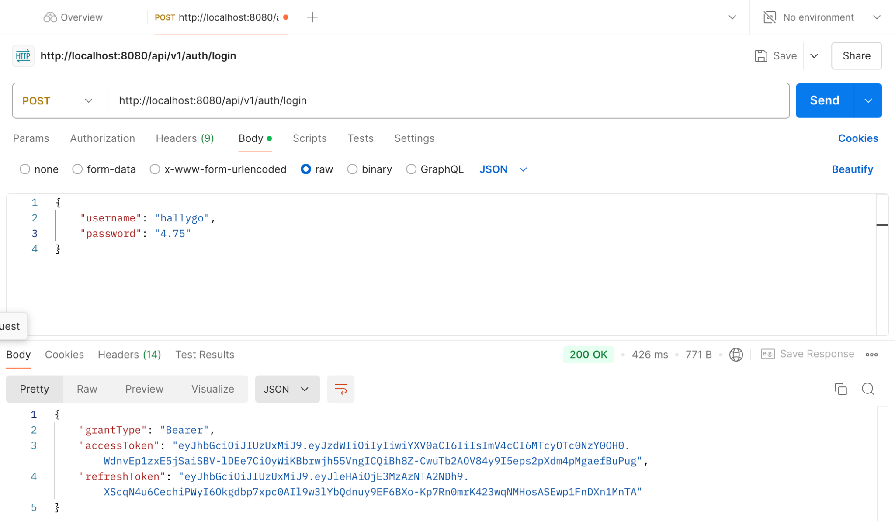
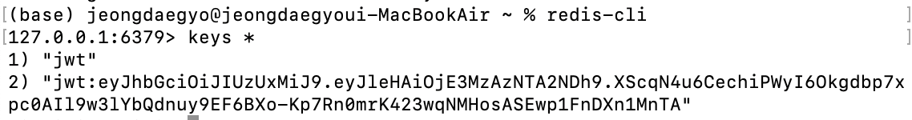
Demo : Auth Test
Log In
Notes:
When users log in, they are issued accessstoken and refreshtoken, and refresh token is stored on the server.
로그인을 하면 accesstoken과 refreshtoken을 발급하고 refreshtoken은 서버에 저장
refreshtoken -> server 저장 -> 토큰의 장점인 클라이언트 사이드에 저장돼서 서버가 stateless하다는 장점이 없는 것 아닌가?
액세스 토큰은 stateless하게 클라이언트에 저장하고, 리프레시 토큰은 서버에 안전하게 저장하여 보안을 강화하는 방식입니다.
이 접근 방식은 보안과 성능의 균형을 맞출 수 있도록 도와줍니다.
결국, 리프레시 토큰을 서버에 저장하는 것이 stateful하긴 하지만, 이는 보안을 위한 전략으로 볼 수 있습니다

Slide 29
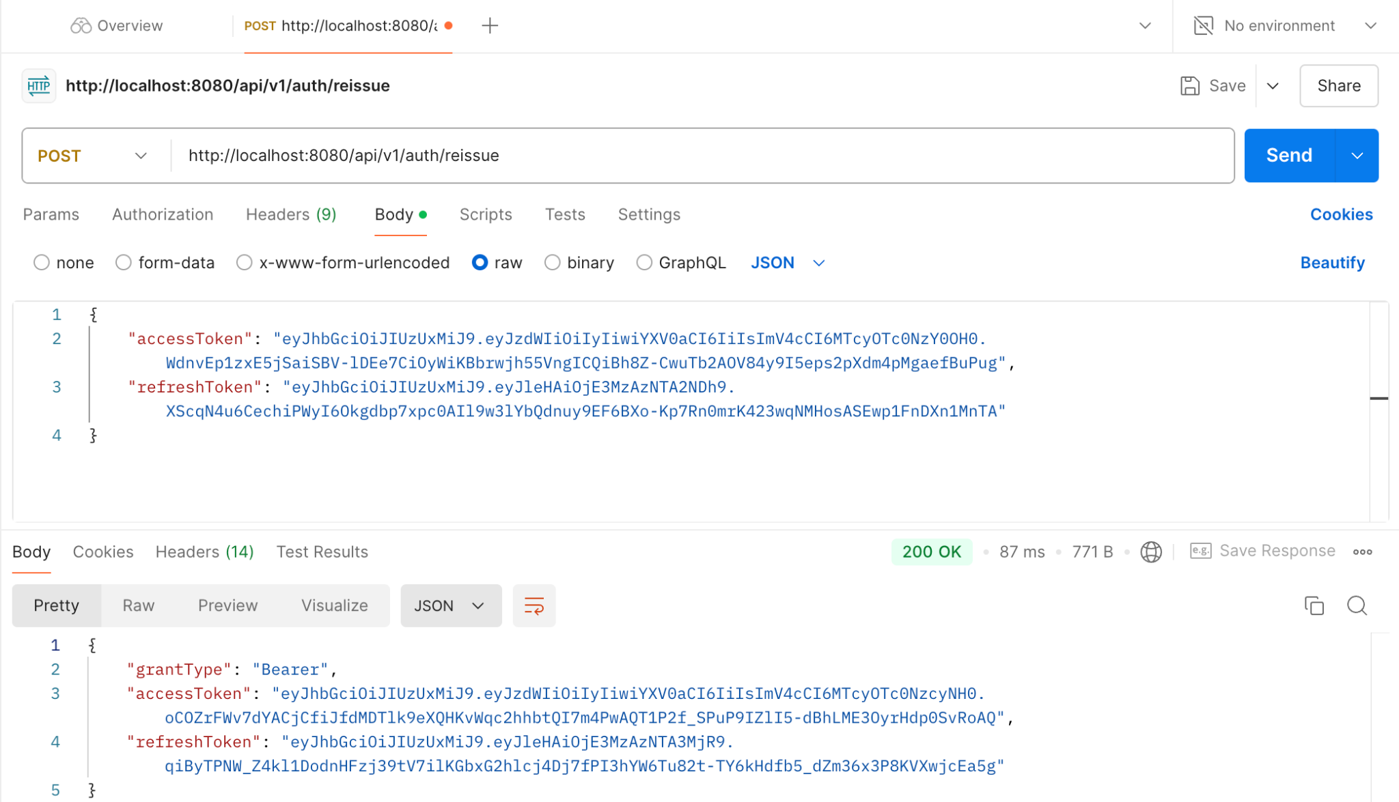
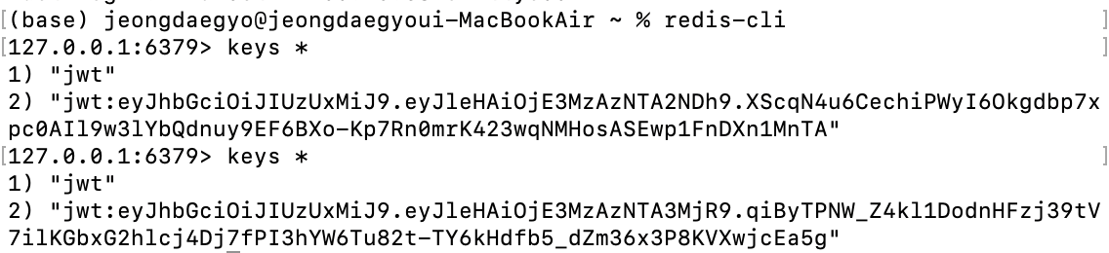
Demo : Auth Test
Reissue

Slide 30
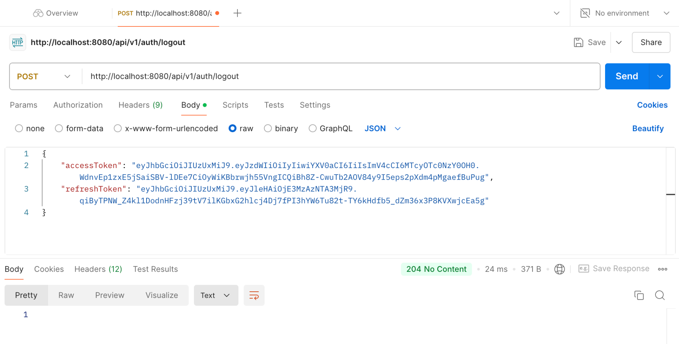
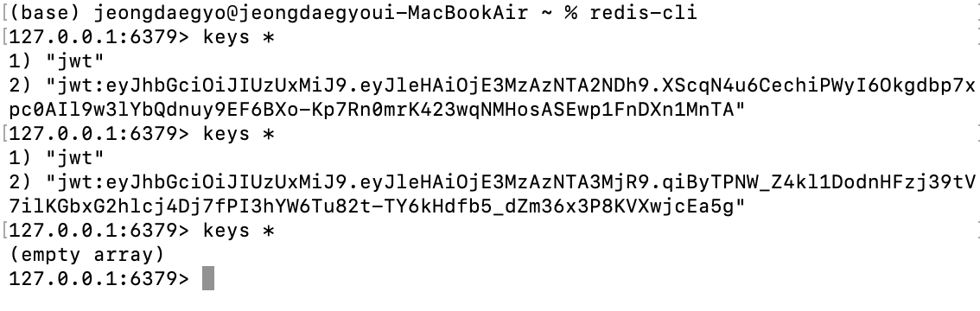
Demo : Auth Test
Log Out
Notes:
When a user logs out, the refresh token of the account is deleted.
로그아웃을 하면 해당 계정의 refreshtoken을 삭제함

Slide 31
Thank you for listening

